Slide 1
Assignment 6.2 Charts
DSC640
Taniya Adhikari

Slide 2
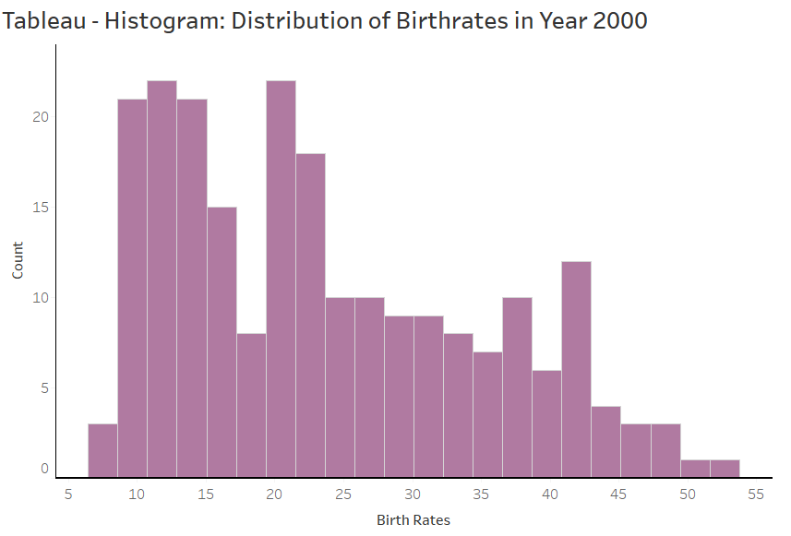
Tableau – Histogram

Slide 3
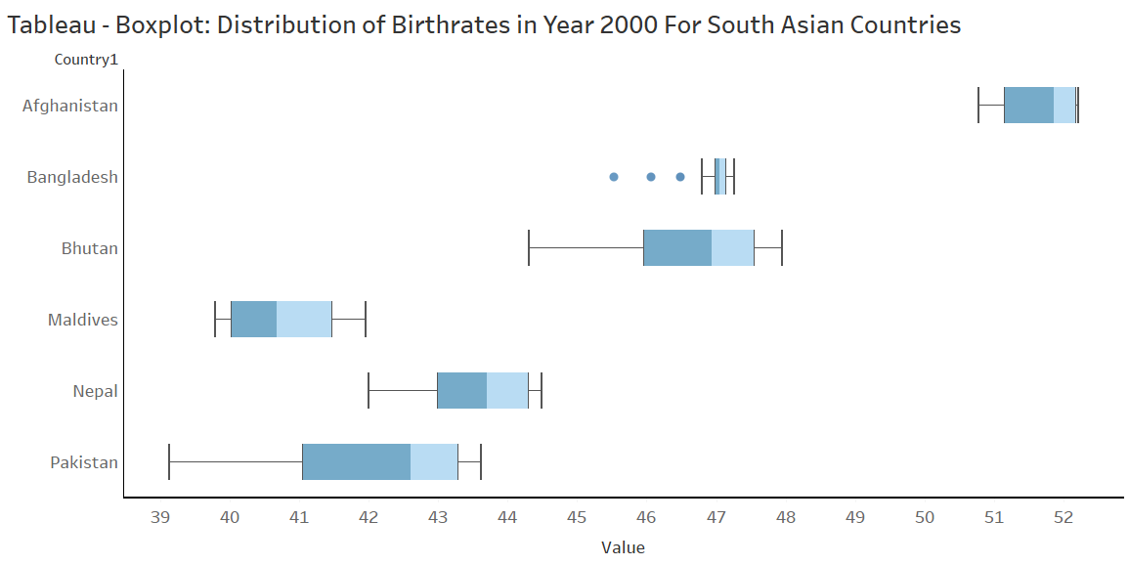
Tableau – Boxplot

Slide 4
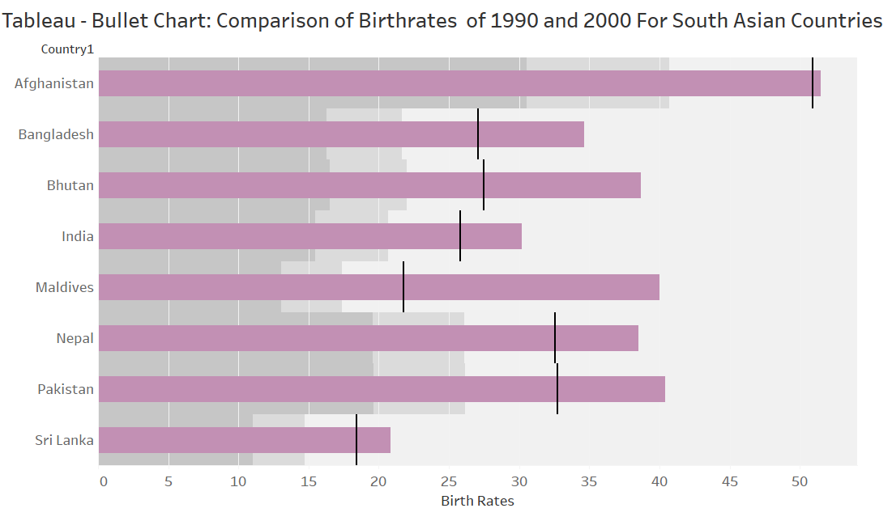
Tableau – Bullet Chart

Slide 5
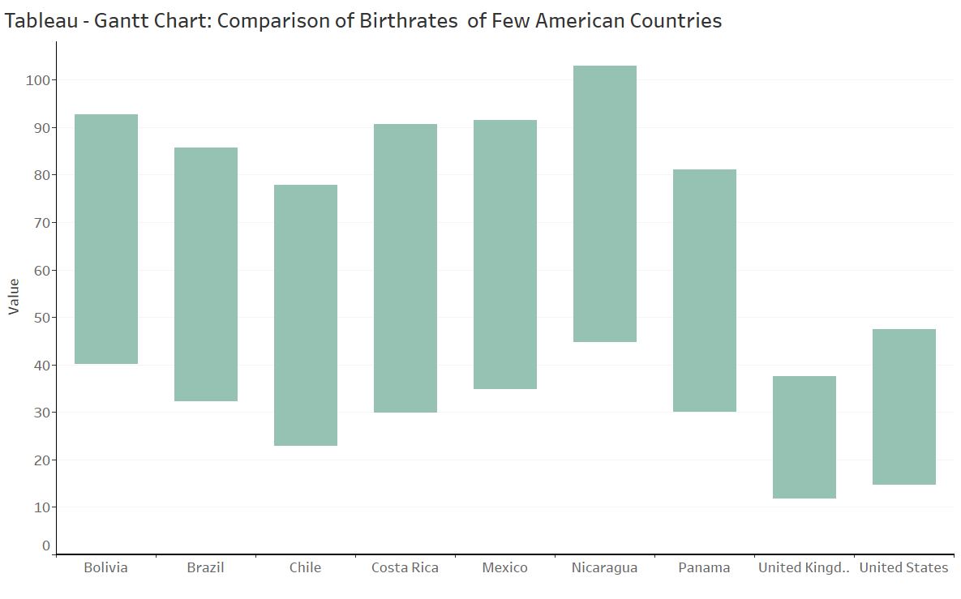
Tableau – Gantt Chart

Slide 6
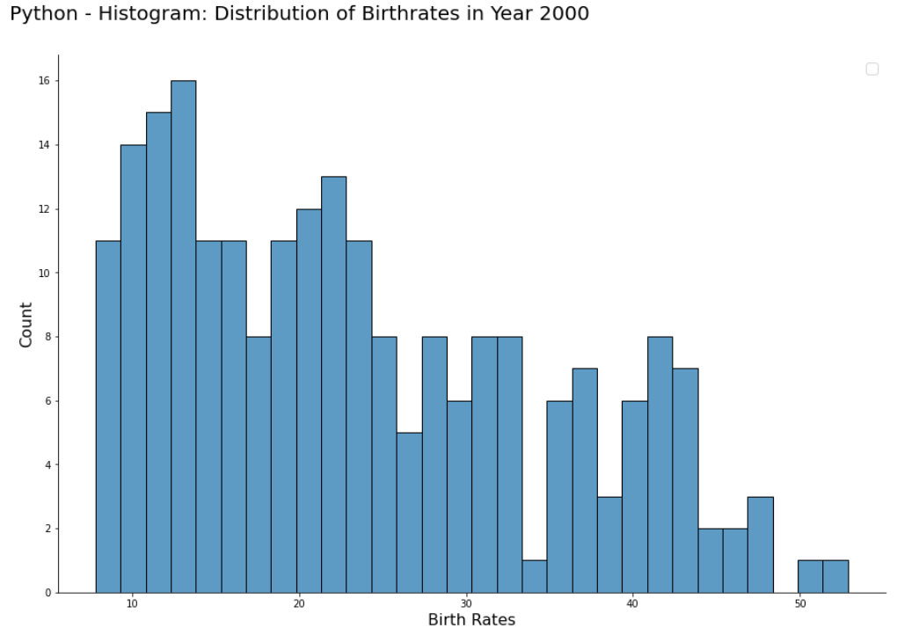
Python – Histogram

Slide 7
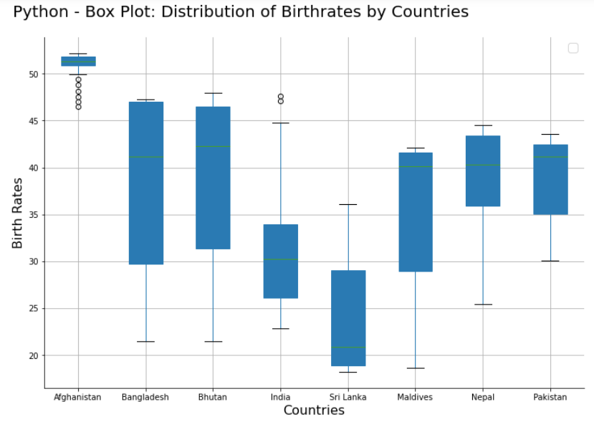
Python – Box Plot

Slide 8
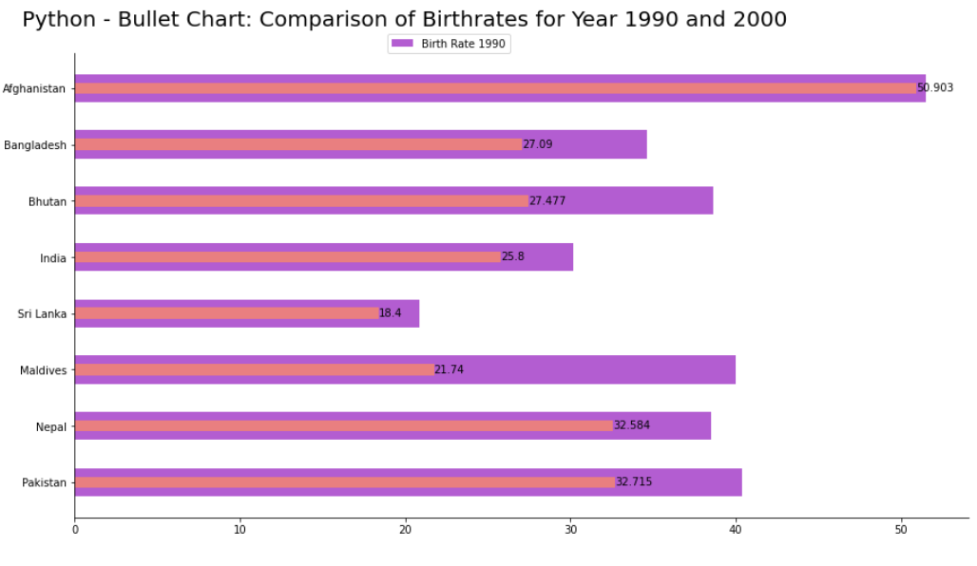
Python – Bullet Chart

Slide 9
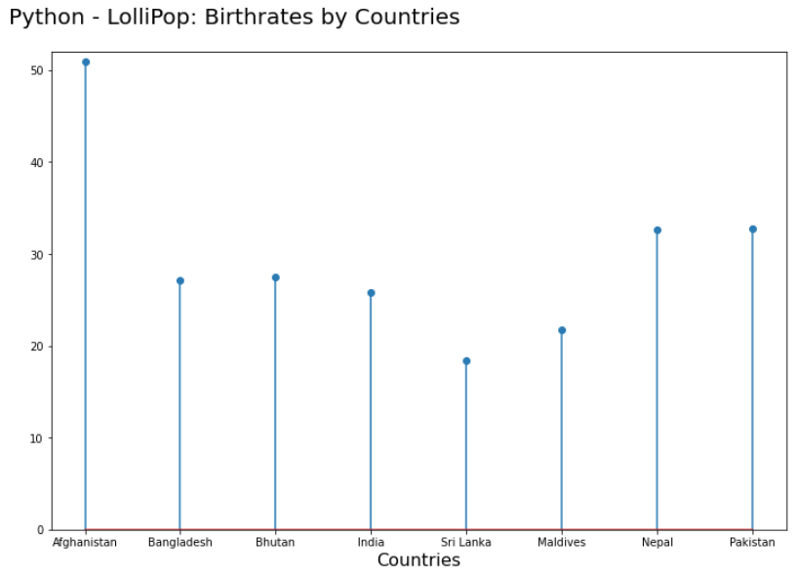
Python – Lolli Pop Chart

Slide 10
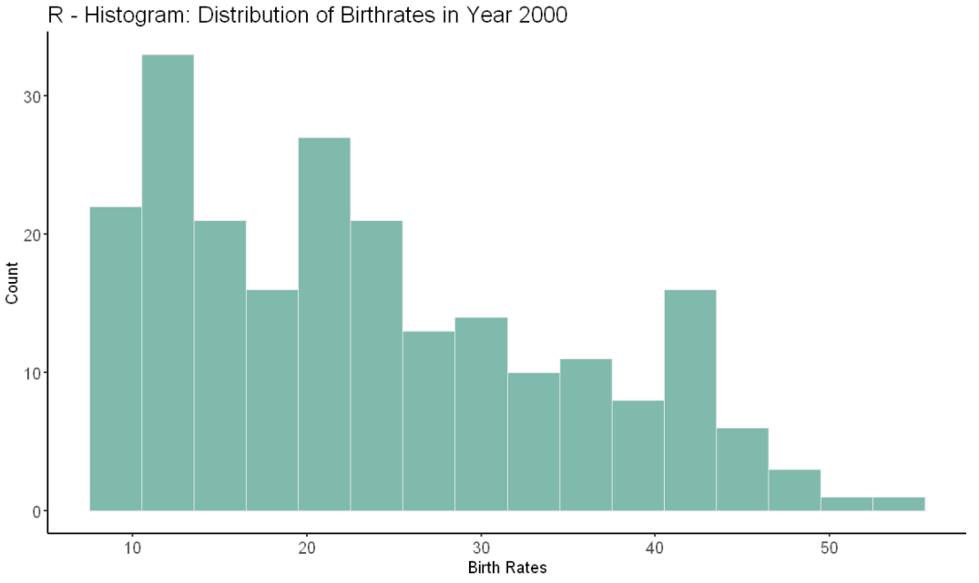
R– Histogram

Slide 11
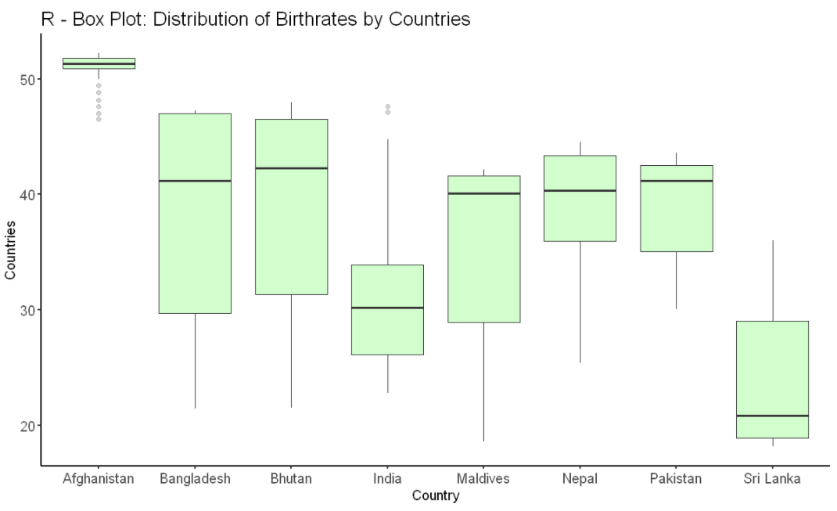
R – Boxplot

Slide 12
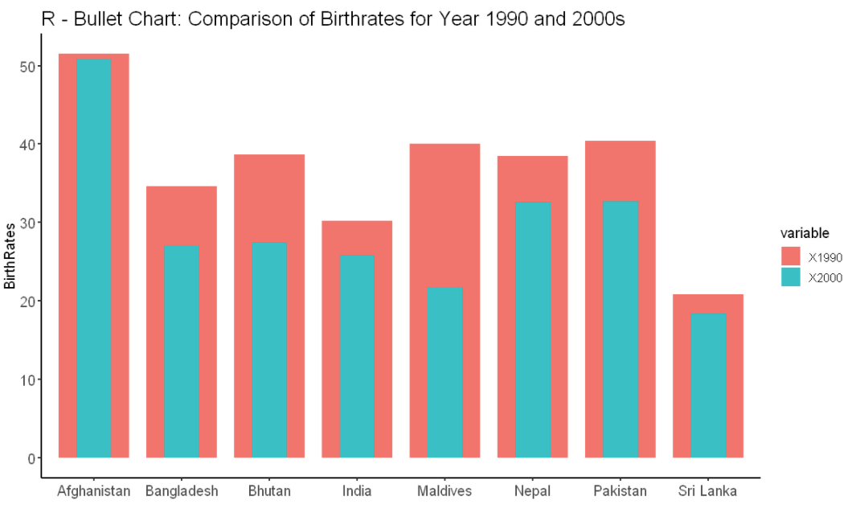
R – Bullet Chart

Slide 13
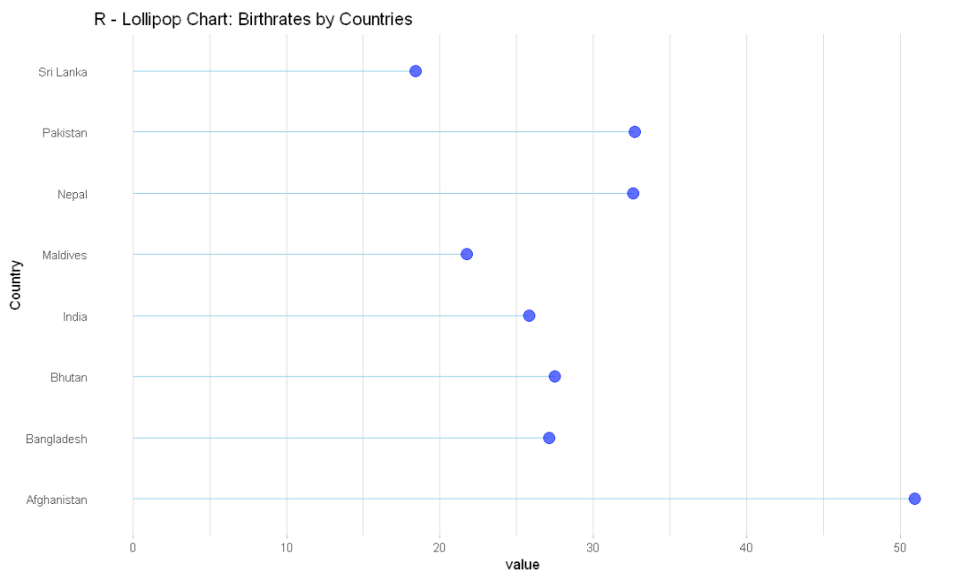
R – LolliPop Chart

Slide 14
Supplemental Files
Tableau Screenshot
Python Code
R Code

Slide 15
